Slide 1
CSS Lab Questions
https://www.w3schools.com/css/css3_multiple_columns.asp
https://www.w3schools.com/css/css3_colors.asp
https://www.w3schools.com/css/css3_backgrounds.asp

Slide 2
Question 1 – CSS Classes and IDs
Using the files imagine.txt and imagineCover.png on Moodle, create an html file and a stylesheet to look exactly like the screenshot on the next slide.
Use a class to colour the word Imagine each time it appears
Use separate IDs for both choruses
Set the picture as a background picture, and set it not to scroll

Slide 3
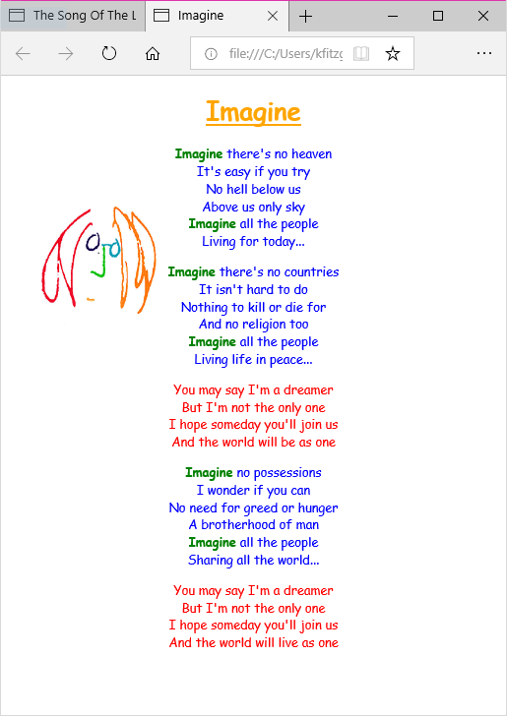
The image is on the background and is fixed
There should be only one class and two ids used in this example
The font family is Comic Sans MS
All text and images area available on Moodle

Slide 4
Question 2
Create a page called lonelyMountain.html
Style this page to include a multicolumn layout as illustrated on the following slide
All files and text are available on Moodle
Pay attention to the transparency/opacity of the white background of the main semantic block
Use the w3school for references.

Slide 5
